Slide 1

Improving Our
Fire Departments

Slide 2
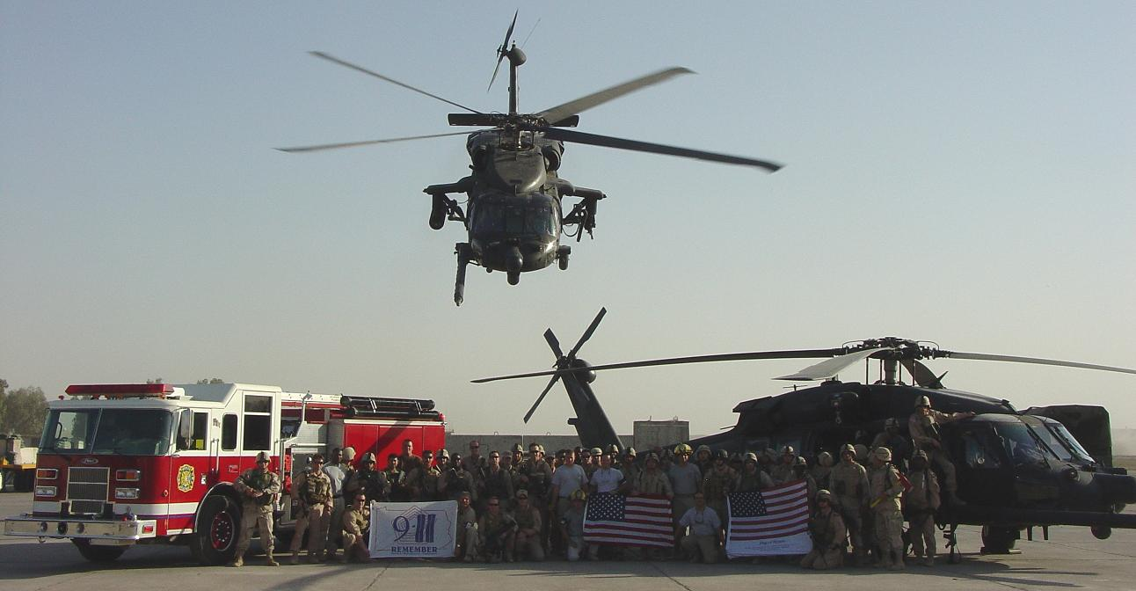
God bless the men and women who have
and who are protecting our freedom

Slide 3
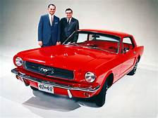
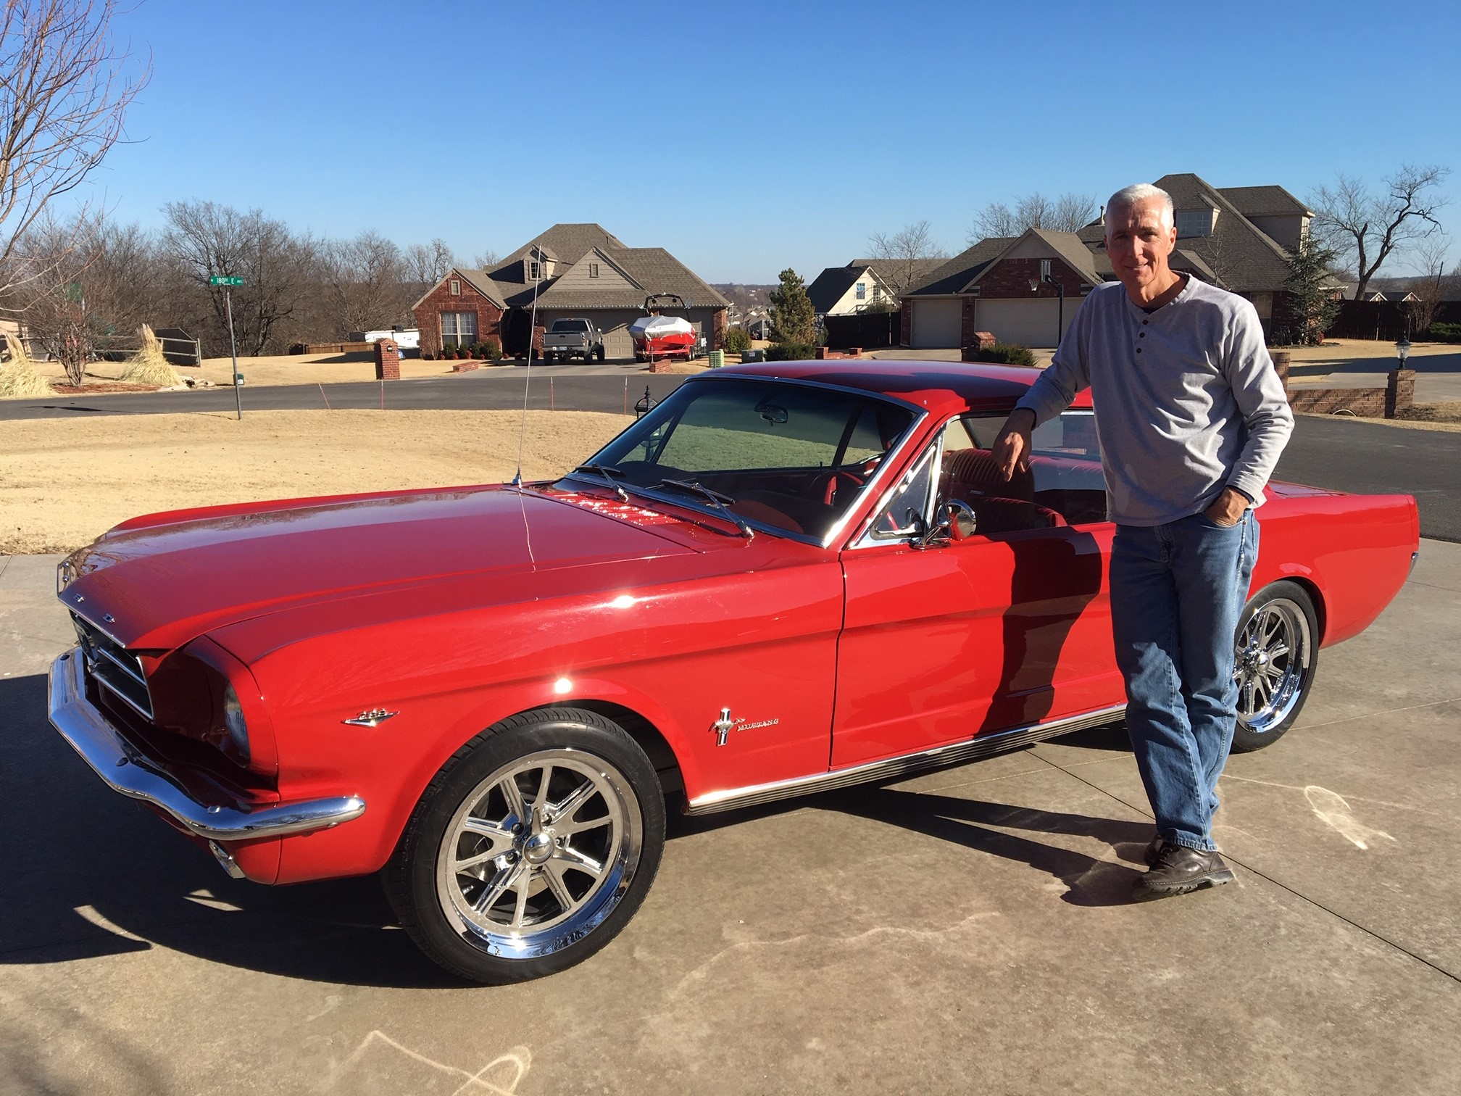
Deepest Sympathies to Michigan Son and Automotive Legend Lee Iacocca
1964
2019

Slide 4
The American firefighter today is the highest type in our history;
they are educated, inspired,
they display endless initiative,
they are attentive and cheerfully
susceptibility to discipline.
Led well they will endure extreme
hardships go thru hell and high water
to complete their duties.

Slide 5
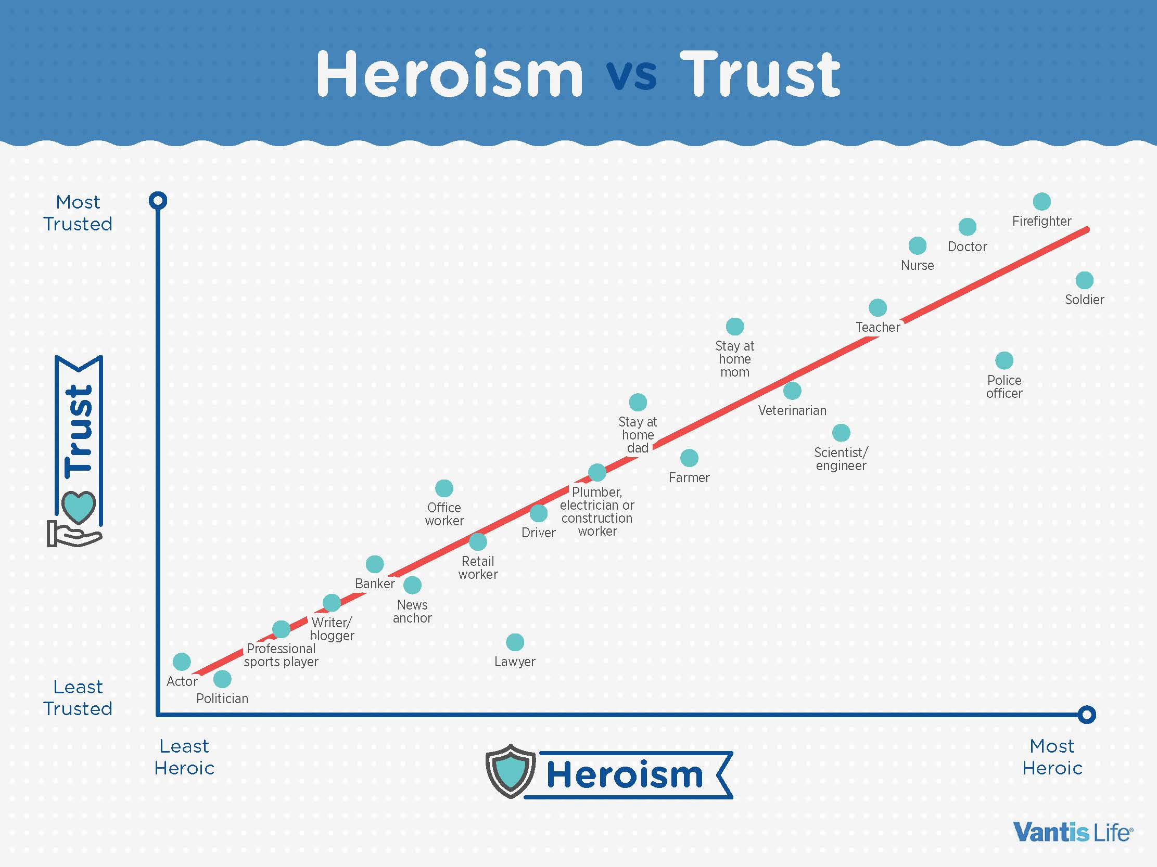

Slide 6
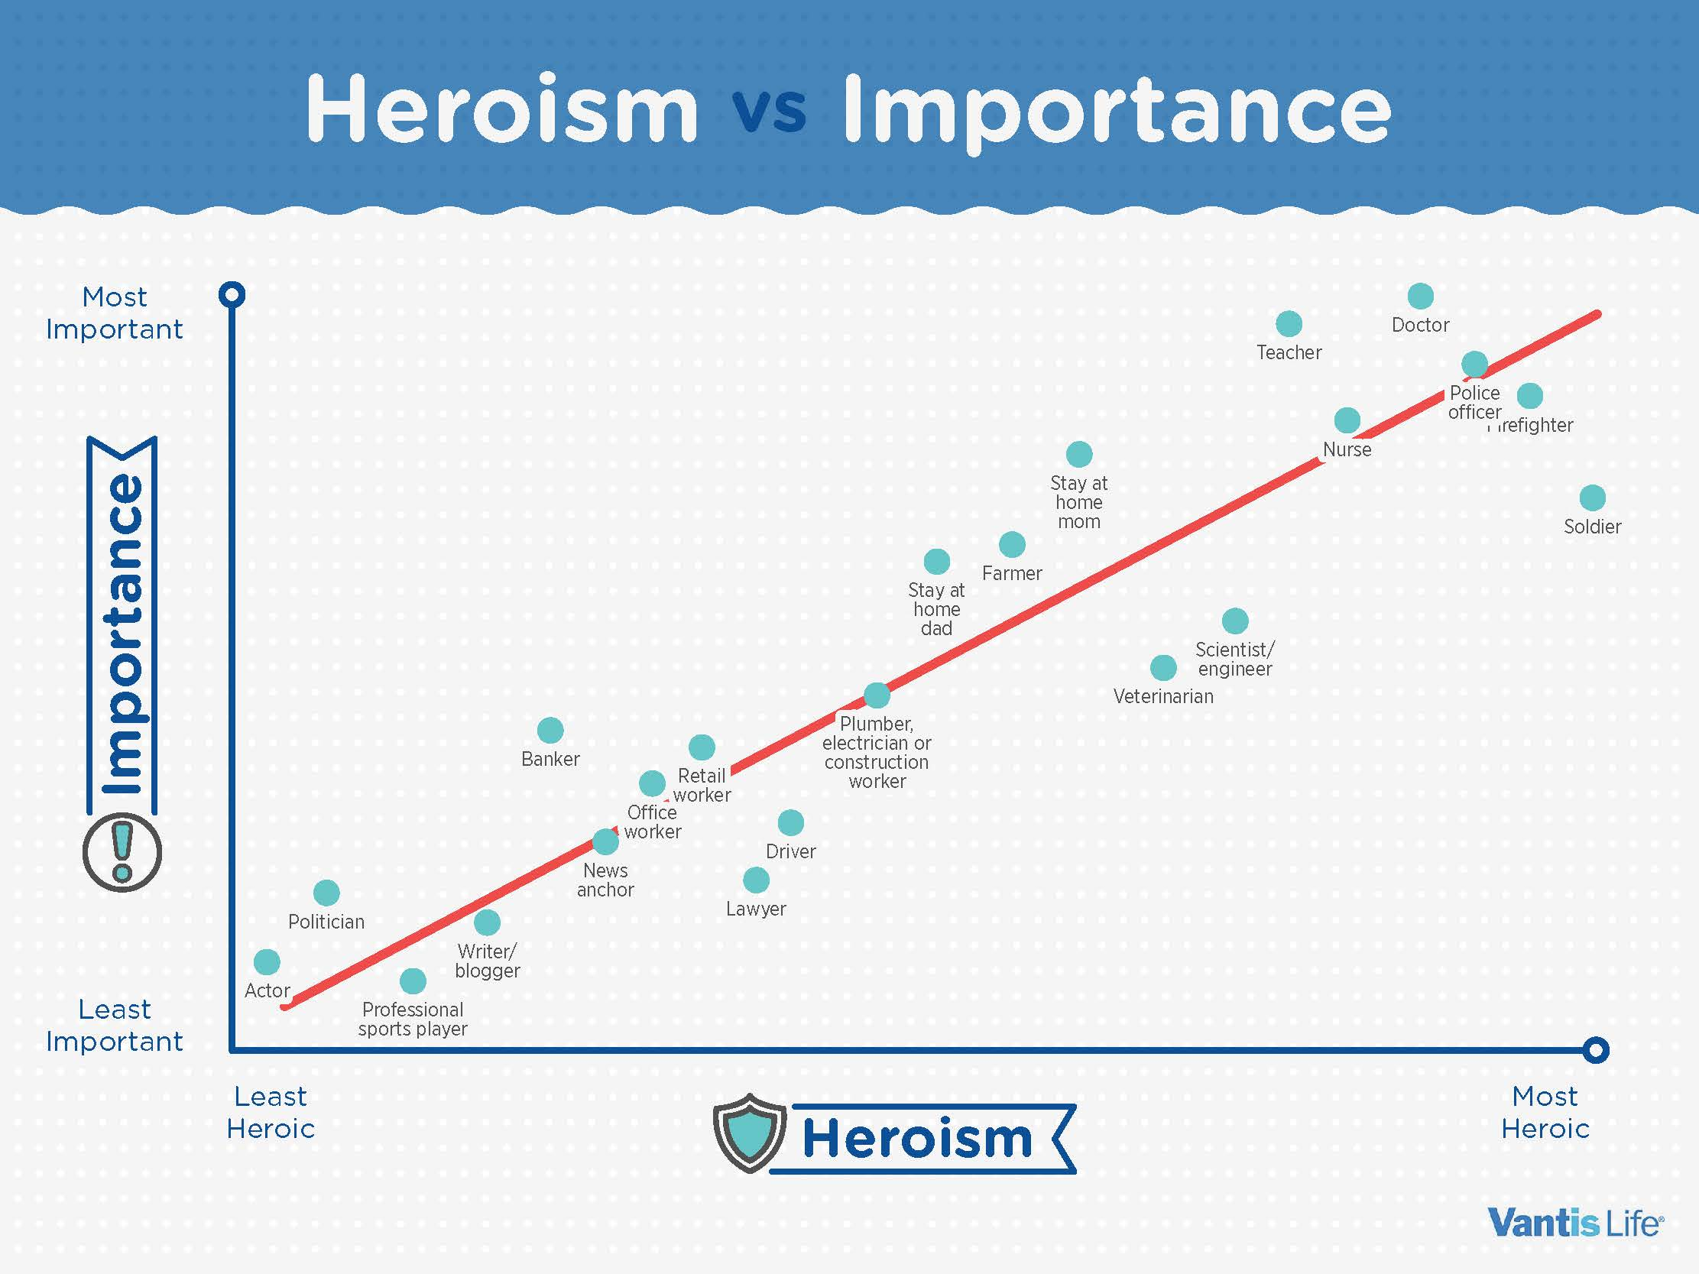

Slide 7
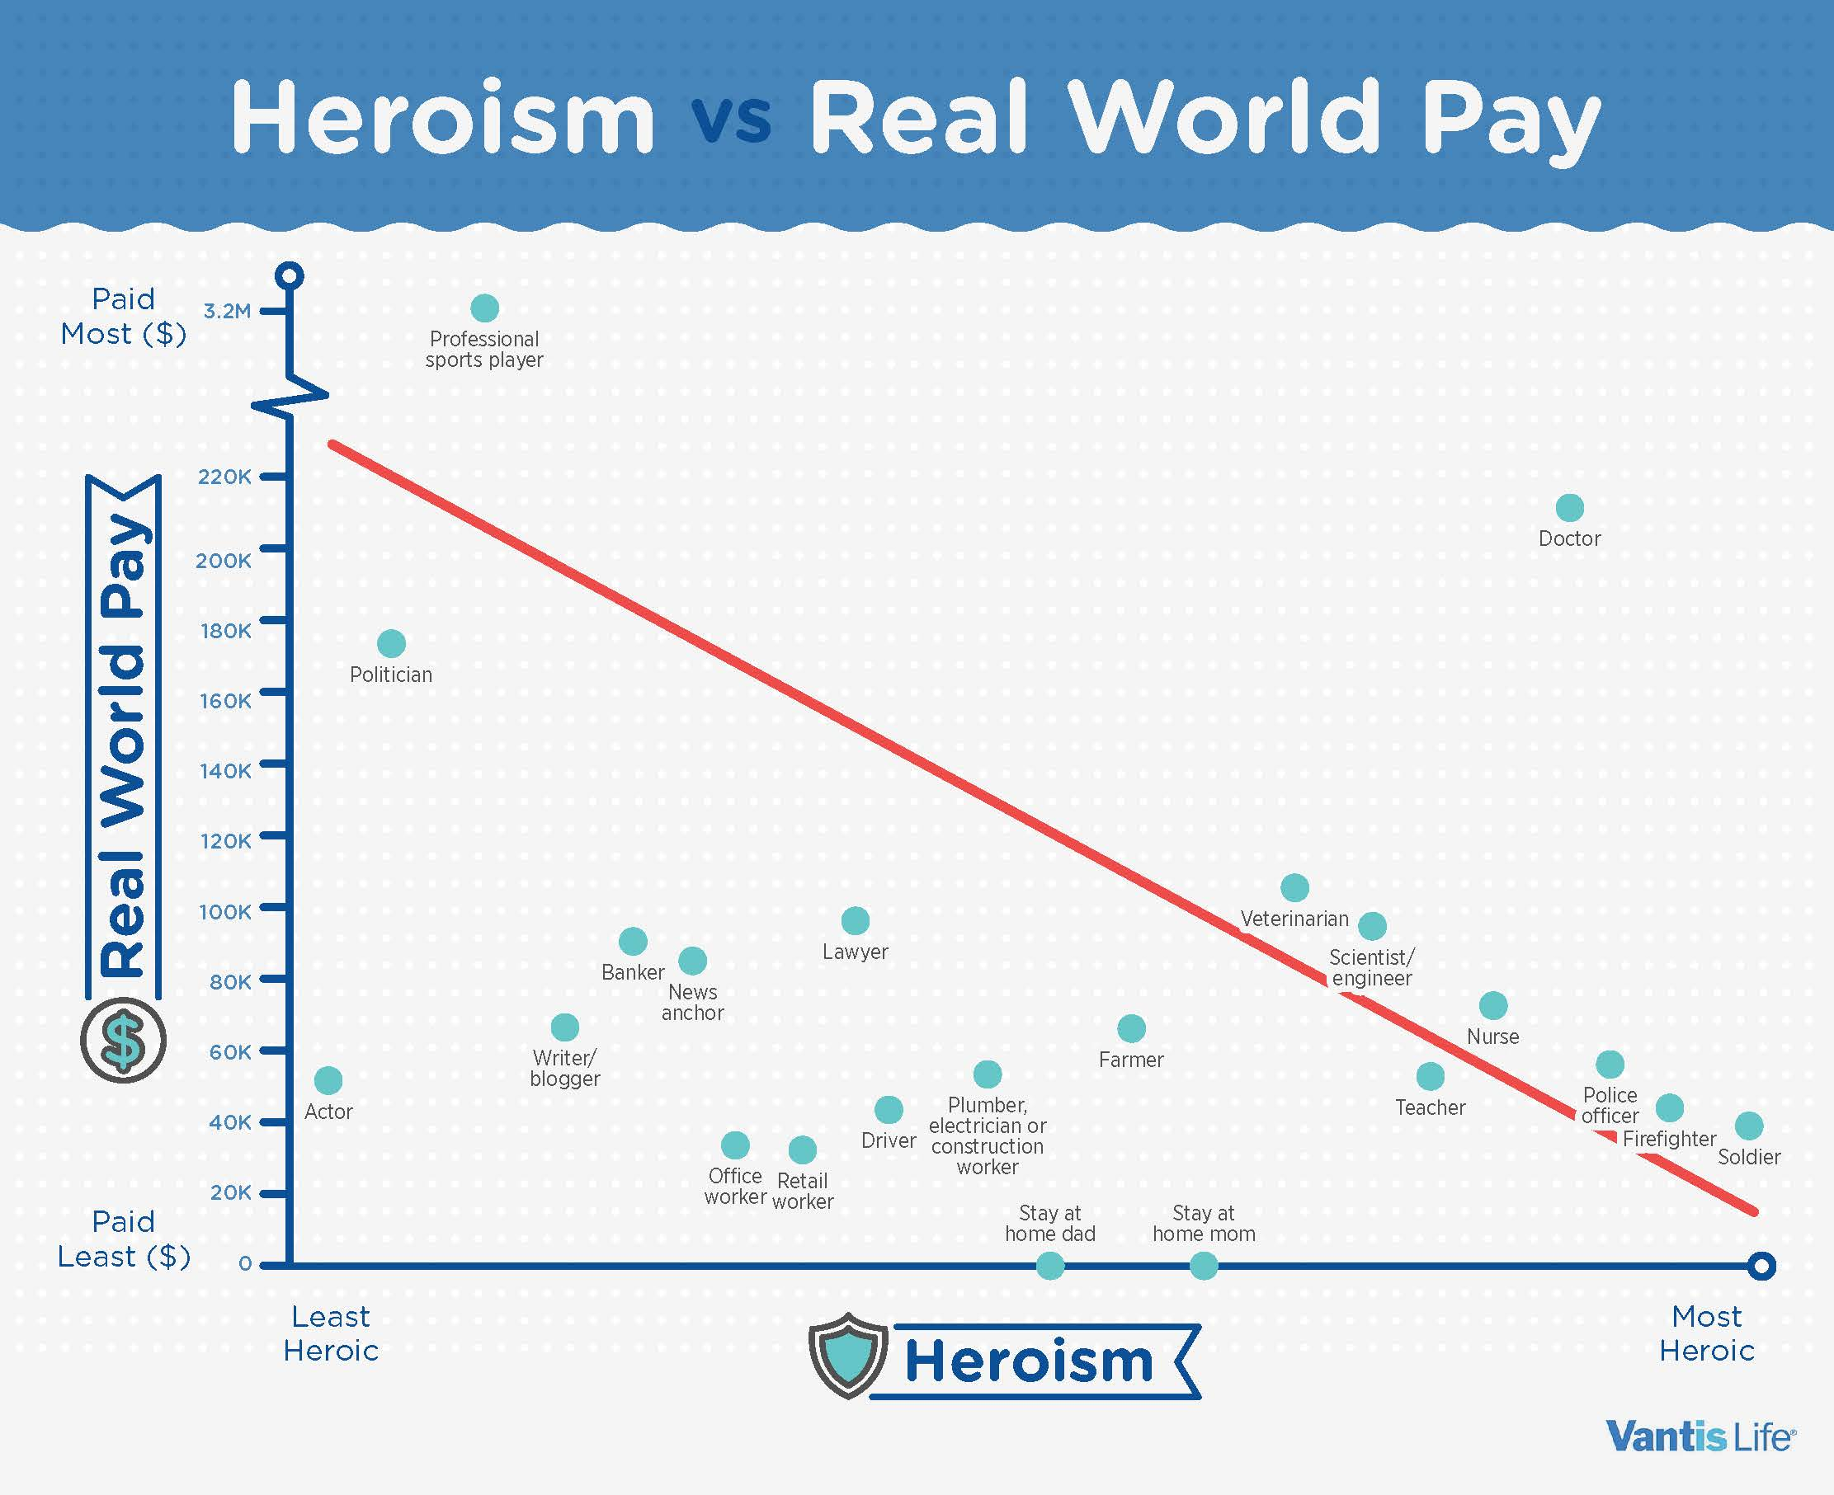

Slide 8
“Whatever anyone does or says, for my part I’m bound to the good.
In the same way an emerald or gold or purple might always proclaim
Whatever anyone does or says,
I must be what I am and so my true colors”.
Marcus Aurellius

Slide 9

Life, Rules, Expectations, Obstacles, Tools
Local, personal, models, culture, expectational
General, community, societal expectations,
Universal, worldwide, idealized
Good Person
Skills, firefighter, Parent, contributor
Manners, appearance, language,

Slide 10

Lets take a few minutes
What programs, goals, objectives do you believe are most critical to your department at this juncture
  Write down one and what would be necessary to get it done
  Use bullets and identify people or positions
What are your personal objectives, goals
  Write down how you will get there
  Use bullets be general

Slide 11
Pre-Mortem Exercise
On department goals, list all the ways it could go south
List all the ways you could contribute to them going south
On the personal goals, same drill

Slide 12

Worldview without anomaly
Expectations Goals, Rewards, Success
Hard work, dedication, loyalty, discipline, sacrifice
When we travel thru time and our expectations are met and order ensues or the world works as we expect we feel, good normal, accepted

Slide 13
Worldview with anomaly
Expectations, Goals, Rewards, Success
Hard work, dedication, loyalty, discipline, sacrifice
When we travel thru time and our expectations, beliefs, worldview are challenged, broken or worse, we feel disappointment, confusion, shame, chaos

Slide 14
Individual and Organizational Elements
Moral Purpose
Capacity
Individual
Collective
Individual
Collective

Slide 15
Individual and Departmental Goals
Self Preservation
Advancement
Meaning
Recognition
Cultural Survival
Improvement
Purpose
Understanding

Slide 16
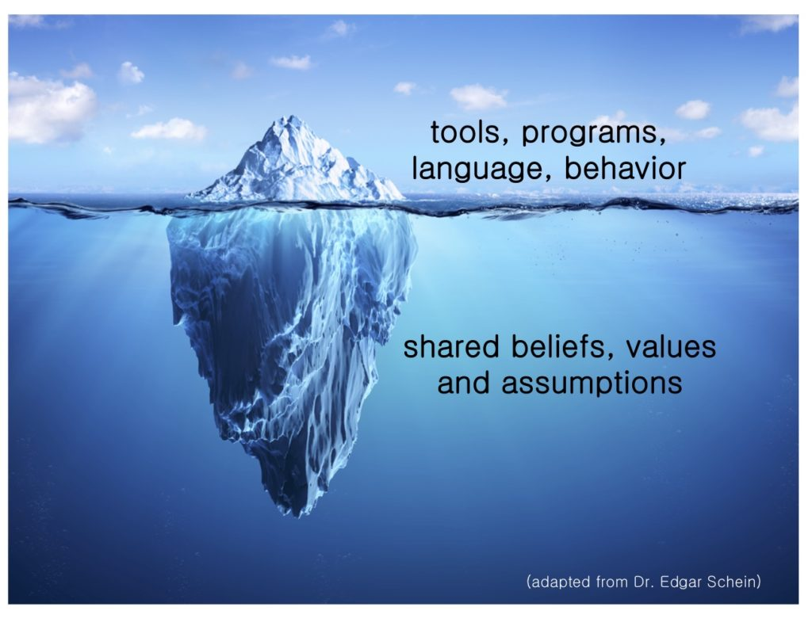
Human and Organizational Performance
Dr. Schein’s model:
artifacts (visible organizational structures and processes)
espoused beliefs (values, goals, visions)
basic assumptions and beliefs (unconscious beliefs, perceptions, feelings)

Slide 17
The HOP philosophy is at the bottom of the iceberg, not the top
HOP is a group of principles or organization beliefs that: shape our programs, tools, behaviors, and language
HOP adjusts the department’s shared beliefs around: blame, error, the definition of safety, the role of the worker, complacency, risk normalization, contextual influence, failure, the importance of learning from normal work
With the end goal of creating more resilient FD

Slide 18
Human and Organizational Performance
What is HOP?
  cross between system design and psychology
HOP also called the “New View” “System II”
  using the social sciences to better understand how to design resilient fire departments.
We cannot manage what we don’t understand.

Slide 19
Human and Organizational Performance
Engineering language:
humans fail (make errors and break rules) with a known frequency that is affected by known influencing factors
If we take those data inputs as a given, we design better systems – including better rules, and better methods of discipline

Slide 20
Human and Organizational Performance
We have biases that lead us to judge others’ decisions more harshly than our own
We believe others have complete access to all necessary information and have full autonomy while making a decision…but they don’t
This misunderstanding is magnified by the fact that we undervalue workers.

Slide 21
HOP Basic Principles
HOP Principle 1: Mistakes Are Normal
HOP Principle 2: Blame Fixes Nothing
HOP Principle 3: Context Drives Behavior
HOP Principle 4: Learning Is Key
HOP Principle 5: How Management Responds to Failure Is Key

Slide 22
Human and Organizational Performance
The New View gives us the terminology and the platform to disrupt the paradigms that hinder our ability to be transformational leaders.
The choices we make today about how we ask questions, how we create rules, how we react to failure (how we treat people) will directly impact our fire departments in the future.

Slide 23
Thoughts to consider on planning
Recognize each department (and parts of that department) have different shared beliefs, values and assumptions.
  Learn what they are and build off of them
Find your advocates and build the plan with them.
  Those closest to the work know the details needed to forge a path of change better than anyone (Skin in the Game)
A plan built on assumptions will fall short.

Slide 24
Thoughts to consider on planning
Rely on evidence relevant to your context
Consider all levels of the Social Ecological Model and the participants’ perspectives at each level
Foster community participation
Develop a program that is culturally sensitive and relevant
Not make assumptions about the populations/participant

Slide 25
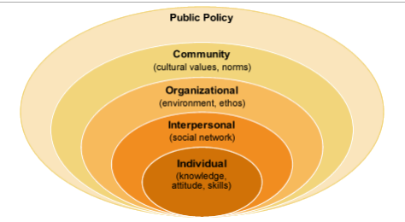
Social Ecological Model

Slide 26
Back to Pre-Mortem
Leadership Interest: garnering leadership support
Building HOP fluency: education around, and continued exposure to HOP Principles to facilitate a paradigm shift in thought
Operational Learning: practicing how to learn and improve, both proactive and reactively
Alignment: building HOP principles and operational learning mechanisms into existing processes, programs, and practices
Safeguard Management: using operational intelligence to continuously design, iterate and manage safeguards

Slide 27
Command & Leadership
Invest in good actions:
Everything you have can be taken away…except good deeds and virtue.
Lucius Annaeus Seneca, aka Seneca the Younger
Roman Stoic Philosopher

Slide 28
“In a world where you have command but strive for legitimate leadership you need three things to thrive but two to survive”

Slide 29
Number one
Be a good officer if you don’t know what’s expected of your people and you don’t know what they go through, you don’t know what you’re doing.

Slide 30
Number two
Be a good pilot, if you don’t know your shit you’ll be dead before you can make any argument to the contrary.

Slide 31
Number three
Be a good dude. “If I have to explain that last one to you I can’t help you”
Lt.CMDR. Dean “Drama” Halton USN

Slide 32
Modesty
“The best lack all conviction, while the worst / Are full of passionate intensity.”
William Butler Yeats

Slide 33
We cannot manage what we don’t understand
What influences people to break rules?
What is wrong with the concept of root cause?
How have we misunderstood causality?
Why can’t a perfect procedure exist?

Slide 34
We cannot manage what we don’t understand
Why will one set of corrective actions work for some people and not for others?
Is complacency a choice?
Understanding the truth behind questions like these is crucial to good leadership.

Slide 35
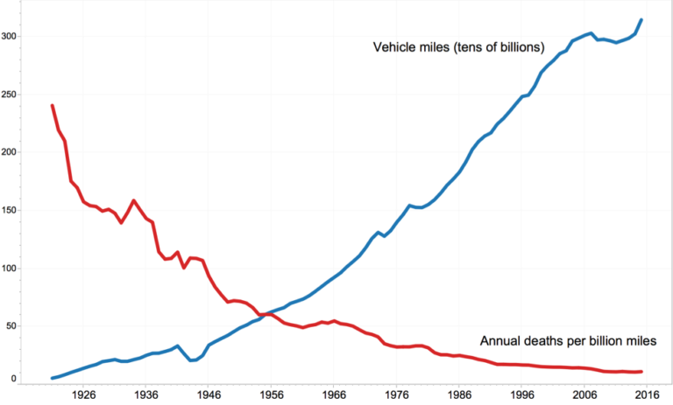
HOP is not a program /
The New View is a philosophy
when adopted, creates a local culture change

Slide 36
Human and Organizational Performance
The premise of HOP is the idea that human error is inevitable so perhaps through better process systems management and analysis, organizations might lessen the effect of human error through the promotion of defenses that reduce risk.

Slide 37
Complex Adaptive Systems
Complex systems are not fully predictable
  uncertainty is recognized as a natural part of a CAS
Embrace the complex nature of firefighting
  look beyond traditional cause and effect relationships
Recognize every work evolution has unique attributes

Slide 38
Three Concepts
Justice
Accountability
Restoration

Slide 39
Firefighter LODD Report

Slide 40
At 0113 hours, the fire department was dispatched to a report of residential structure fire. The dispatcher advised that heavy, black smoke was showing. The dispatcher advised at 0114 hours that two elderly people may be in the house. Additionally, the dispatcher stated there was smoke coming from the basement in the back of the house. These last two transmissions were on the dispatch channel and not simulcast on the tactical channel.
Quint 25 responded at 0114 hours and was on-scene at 0117 hours. Upon arrival, the acting officer of Quint 25 met a police officer who advised him that the neighbors reported two residents possibly inside. Heavy smoke was showing from the front half of the house, but no flames were visible.
The acting officer of Quint 25 told the fire fighter on Quint 25 to get the thermal imager and take the irons to the front porch (Side Alpha). The acting officer from Quint 25 walked along Side Bravo to Side Charlie. He then proceeded back to Side Alpha. He advised the dispatcher at 0118 hours that smoke was showing from three sides of a residential structure but he could see no visible fire.
The acting officer of Quint 25 decided to enter the house through the front door, which was on Side Bravo/Side Alpha corner. The engineer from Quint 25 had stretched a 1¾-inch hoseline to the front door. The fire fighter from Quint 25 forced the front door. The fire fighter from Quint 25 made entry into the foyer and then turned right into the family/living room. The acting officer of Quint 25 was behind the fire fighter on the hoseline. The acting officer of Quint 25 stated that the smoke was about a foot off the floor but not hot. As the Quint 25 fire fighter crawled into the family/living room, the floor collapsed and the fire fighter immediately fell into the basement.

Slide 41
Timeline
01:18:12 Hours Quint 25 asks if confirmation had been made that the occupants were out
01:18:16 Hours Battalion 20 arrived on-scene, Batt 20 assumed Command
01:20:12 Hours Engine 24 arrived on the scene
01:20:21 Hours Medic 22 arrived on the scene
01:21:40 Hours Quint 25 (PAR 2) made entry through the front door
01:22:12 Hours Engine 21 arrived on-scene
01:23:11 Hours Command ordered everyone out of the building
Quint 25 FF falls through floor
01:23:26 Hours Engine 24A called a Mayday and stated,
“We got a guy that’s inside.”
01:23:42 Hours Engine 24 advised: “We have a fire fighter inside. It’s flashed.”

Slide 42
Fire Building

Slide 43
Fire Building fire origin

Slide 44
Fire Building

Slide 45
Contributing Factors per NIOSH
Arson fire
Incomplete scene size-up
Wind-driven fire
Lack of tactical priorities (incident action plan)
Lack of resource status management
Lack of command safety
Ineffective dispatch center operations
Lack of a written professional development program

Slide 46
Key Recommendations
As part of the strategy and incident action plan, incident commanders should ensure a detailed scene size-up and risk assessment occurs during initial fireground operations, including the deployment of resources to Side Charlie
Scene size-up and risk assessment should occur throughout the incident
Incident commanders should ensure that the strategy and tactics (incident action plan) match the conditions encountered during initial operations and throughout the incident
Fire departments should develop and implement a standard operating procedure, training programs, and tactics for wind-driven fires.

Slide 47
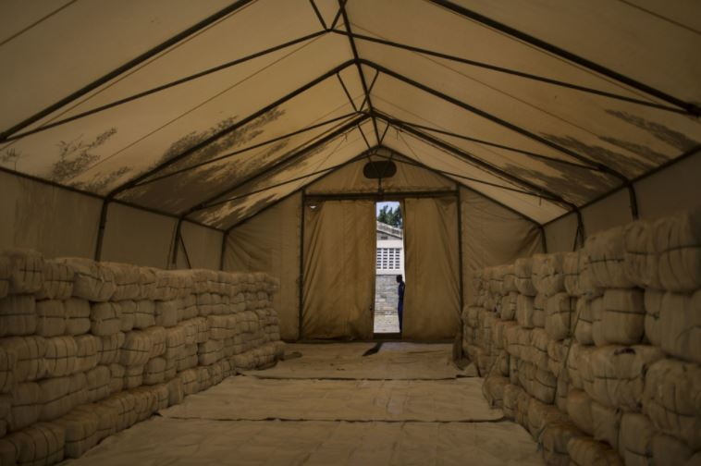
Global Fund to Fight AIDS, Tuberculosis and Malaria, which was financed by the Gates to purchase 450 million nets. Nets are one of the cheapest and most effective ways to stop a disease that kills at least half a million Africans each year.
Uriel Sinai The New York Times

Slide 48
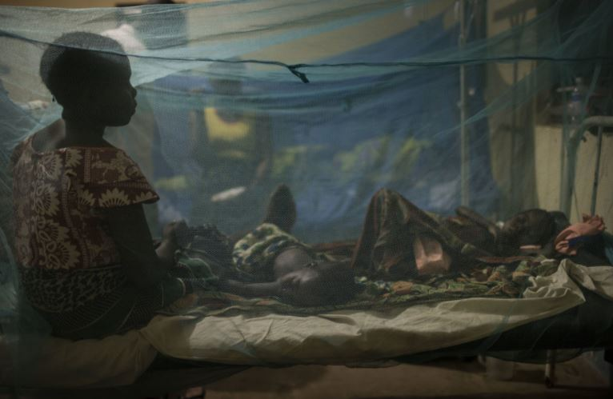
The insecticide-treated mosquito net, hung over a bed, is the perfect mosquito-killing machine. The gauzy mesh allows the carbon dioxide that people exhale to flow out, which attracts mosquitoes.
Uriel Sinai The New York Times

Slide 49
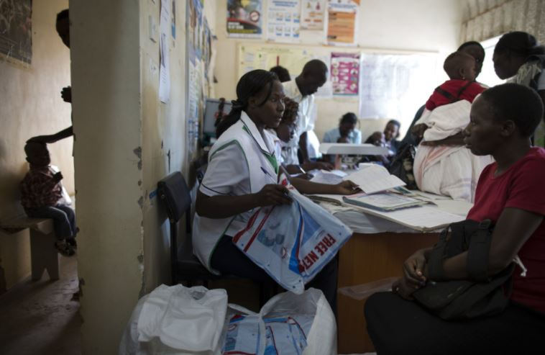
The nets have helped save millions of lives, but scientists worry about the collateral damage.
Uriel Sinai The New York Times

Slide 50
Malaria versus Starvation
Nets are widely considered a magic bullet against malaria
One of the cheapest and most effective ways to stop the disease
But poor residents not using their mosquito nets as intended
Nobody in most huts, including children, sleeps under a net at night
Instead, anti-malaria nets are sewn them together into a gigantic sieve used to drag the bottom of the swamp ponds, sweeping up all sorts of life: baby catfish, banded tilapia, tiny mouthbrooders, orange fish eggs, water bugs and the occasional green frog

Slide 51
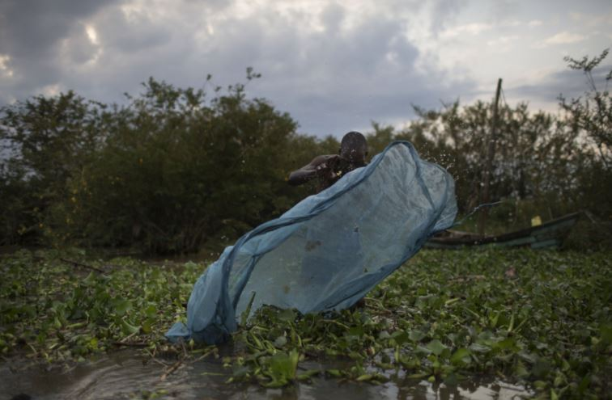
They arrive by the truckload in poor, waterside communities where people have been trying to scrape by with substandard fishing gear. Nets are light, soft, surprisingly strong nets — for free.
Uriel Sinai The New York Times

Slide 52

Nets with holes smaller than mosquitoes, traps much more than traditional fishing nets do. Imperil stressed fish populations, a critical food source for millions of the world’s poorest people.
Uriel Sinai The New York Times

Slide 53

Across Africa, from the mud flats of Nigeria to the coral reefs off Mozambique, mosquito-net fishing is a growing problem, an unintended consequence of most celebrated public health campaign ever
Uriel Sinai The New York Times

Slide 54
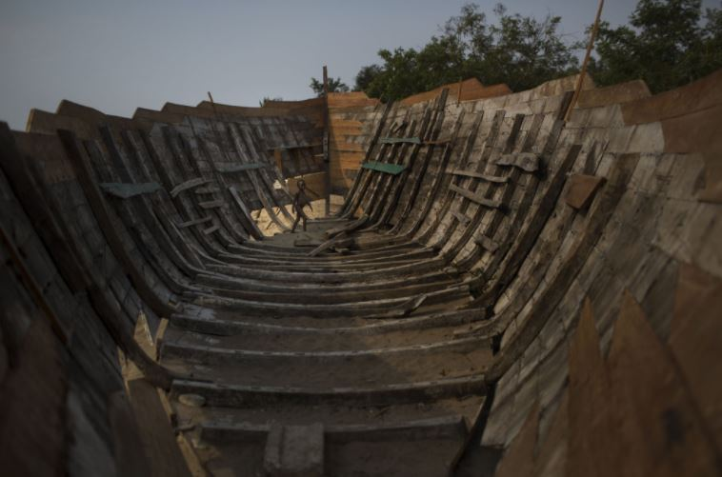
The nets are insecticide-treated nets are treated with permethrin, which is “carcinogenic to humans” when consumed orally. The E.P.A. also says permethrin is “highly toxic” to fish
Uriel Sinai The New York Times

Slide 55
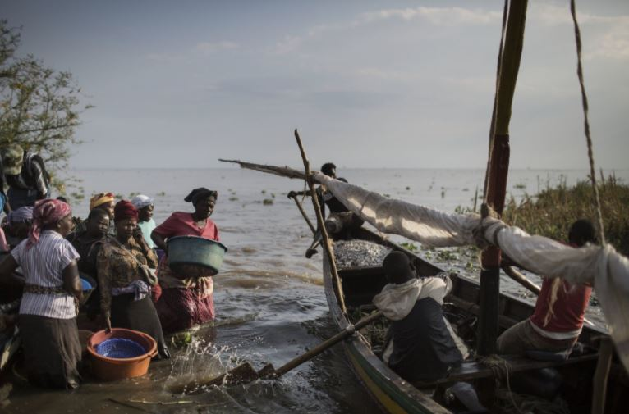
Fistfights are breaking out on the beaches of Madagascar between fishermen who the nets will ruin livelihoods, and those who say they will starve without them
Uriel Sinai The New York Times

Slide 56

Congolese officials have snatched and burned the nets, and in August, Uganda’s president, Yoweri Museveni, threatened to jail anyone fishing with a mosquito net
Uriel Sinai The New York Times
Uriel Sinai The New York Times

Slide 57

Jane, pictured below is facing jail time and fines for fishing with a net . How long would be just, how much should she pay?
Uriel Sinai The New York Times

Slide 58
Contributing Factors
Malaria nets supplied to stop fatal disease misused as fishing tool
Chemical used to kill mosquito kills people /fish /ruins water supply
Incomplete training and warnings
Lack of resources management
Ineffective distribution center operations
Lack of a written correct usage program

Slide 59
Key Recommendations
As part of the Global Fund to Fight AIDS, Tuberculosis and Malaria strategy distribution centers should ensure a detailed assessment of usage occurs during initial mosquito net operations, including the correct deployment of nets
Distribution centers should ensure that the net strategy and deployment (incident action plan) match the intentions during initial operations and throughout the nets lifespan
Global Fund to Fight AIDS, Tuberculosis and Malaria should develop and implement a standard operating usage procedures, training programs, and controls for net usage.

Slide 60
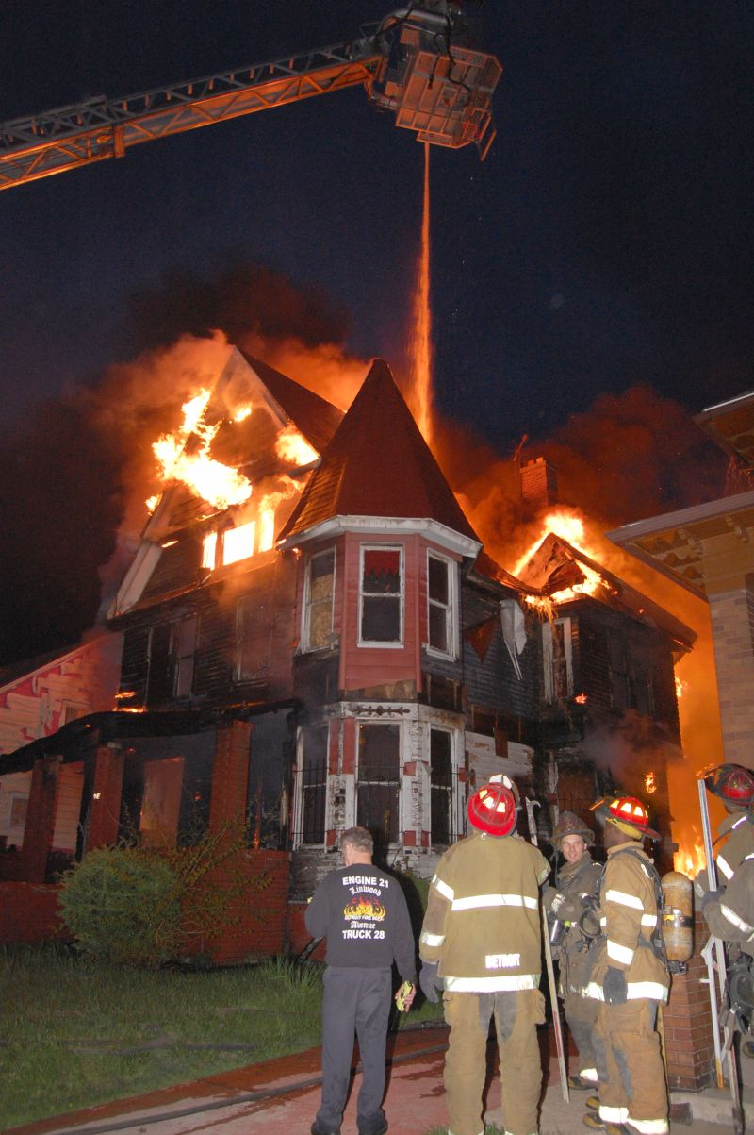
“Context” The Fireground is a Complex Adaptive System
Low Frequency / High Impact
  No discretionary time
  Limited experience
  High stress
  No clear goals
  Inadequate information
  Limited resources
  Uncertainty

Slide 61
Klein’s Recognition-Primed Model
Situation
to affect the
generates
Mental Simulation
Cues
using your
Action Scripts
which you assess by
Mental Models
that let you recognize
that activates
Patterns

Slide 62
System 1 and System 2 Daniel Kahneman
The Fire Incident / System 1 Recognition Primed
Context, incomplete information, conflicting goals, limited time, limited resources, high stakes
Decision making, pattern matching, intuition, emotional, automatic, fast, often unconscious
The Mosquito Nets / System 2
Context, vast amounts of data, clear and distinct goal, plenty of time, extensive resources, high stakes
Decision making, slow, laborious, effortful, deliberate, rational, controlled, conscious

Slide 63
IC’s Responsibilities vs Capabilities from report
At the fire incident, initial information stated there was a possibility of an elderly couple inside the home.
Life safety became the focus of the fire department efforts,
  the initial scene size-up was not completed (no view of conditions on Side Charlie or Side Delta), the 2nd floor access (exterior stairs) to the bedrooms was not assessed, and the rear entrance was not assessed.

Slide 64
IC’s Responsibilities vs Capabilities from report
At any incident, life safety is always the 1st priority, followed by incident stabilization (2nd priority) and then property conservation (3rd priority). A sound risk management plan ensures that the risks are evaluated and matched with the actions and conditions
The following risk management principles should be used by the incident commander:
  Activities that present a significant risk to the safety of fire fighters shall be limited to situations that have the potential to save endangered lives.
  Activities that are routinely employed to protect property shall be recognized as inherent risks to the safety of fire fighters, and the actions shall be taken to reduce or avoid these risks
  No risk to the safety of fire fighters shall be acceptable where there is no possibility to save lives or property [Brunacini 2002].

Slide 65
IC’s Responsibilities vs Capabilities from report
Procedures developed for fireground operations should be flexible enough to allow the change due to:
  Life hazard (must be given first priority
  Problems with water supply and water application
  Volume and extent of fire, requiring large caliber streams
  Location of the fire, inaccessible for hoseline operations
  Materials involved in the fire and explosion potential compounding the problem
  Exposure problems where further fire spread would be a major concern
  Stability of the structure, which would be dependent on the condition of the structural components of the building and the intensity and duration of the fire [Brunacini 2002].

Slide 66
IC’s Responsibilities vs Capabilities from report
The initial incident commander, most often, is a company officer
  assumes command and makes a decision regarding the strategy and IAP
In this incident, the 1st arriving officer was the incident commander, but he never formally assumed command of the incident
Based upon his size-up and risk assessment, the officer of Quint 25 decided to operate in the fast-attack mode
  This mode is applied when quick, immediate action can prevent life loss or injury…… These situations require immediate action to stabilize the incident and require the company officer’s direct involvement in the attack. In this mode, the company officer accompanies the crew to provide the appropriate level of supervision
  Command may be passed to the next arriving officer, upon their arrival
  Command shall not be passed to an officer who is not on-scene

Slide 67
IC’s Responsibilities vs Capabilities from report
“Fireground operations are very dynamic and fast-paced
  (Complex Adaptive System)
The incident commander must determine a strategy and then develop the incident action plan (IAP) to ensure that the proper actions take control of the incident
The incident commander must follow the decision making model that includes:

Slide 68
IC’s Responsibilities vs Capabilities from report
identify incident critical factors (through a situational evaluation or “size up”),
consider the standard risk management plan, declare the strategy (offensive or defensive), and then set tactical objectives
The IAP defines where and when resources will be assigned throughout the incident, along with tasks and objectives [NFPA 2014a].”

Slide 69
IC’s Responsibilities vs Capabilities from report
While developing the strategic goal for the incident is the first component, the incident commander needs to produce detailed tactical objectives that can be assigned to responding companies. Brunacini 2002

Slide 70
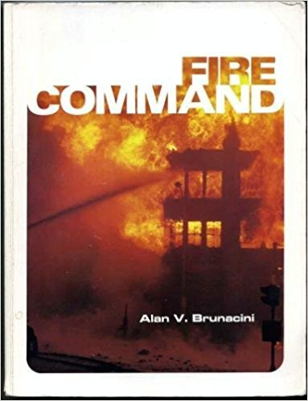
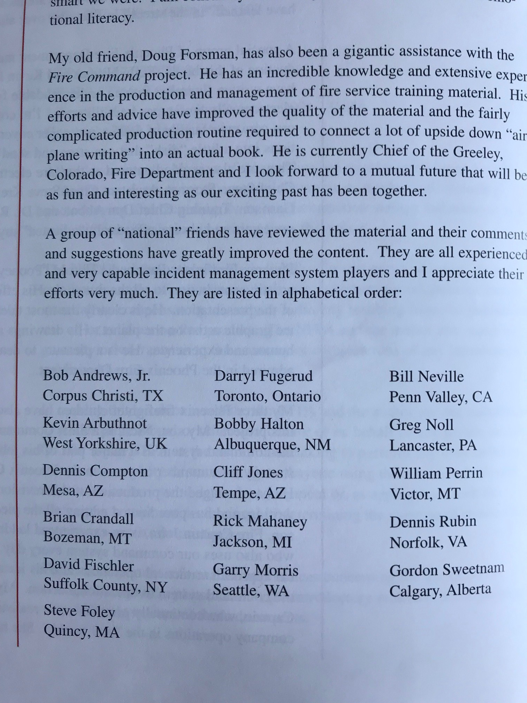
But before the debate the IC role
“Don’t be afraid to make changes. If something has been done a particular way for twenty years, that alone is often a sign that it is being done wrong”
                AVB 1965
Fire Command published October 2. 1985

Slide 71
The Fireground is Complex not Complicated
“In a complex system you can control almost nothing but you can influence everything.” Paul Cilliers
Please pick up a pen and piece of paper……Ready?
Now write down very candy bar name you can think of, candy bar
First arriving company officer must assume command, confirm command location, name command, size up event, spot apparatus, assign crew members, assess risk, assign subsequent arriving units, provide “detailed tactical objectives” to company commanders, complete 360, and find a cure for cancer……….
OR how about Cooperative Command? Who or What Blame or Learn…

Slide 72
Key Points Human & Organizational Performance
1. Pre-Accident Investigations are Better Than Post-Accident Investigations
Much of what safety professionals discover during an incident investigation could have been discovered before instead of after the incident
Having a premortem meeting, a meeting where you ask smart, experienced people what could go wrong before it does go wrong, provides a new set of data about a failure that has yet to happen…

Slide 73
2. Human and Organizational Performance Is a Systems Approach
Many times, safety tends to focus on isolated machines or the actions of single individuals without putting those into a larger context. Human and organizational performance takes more of a systems approach
In a classic root cause analysis (RCA), our job is to deconstruct the event down to its most minute parts, analyze those parts, and fix whatever is broken. In Human Performance, we do almost the opposite. Instead of deconstructing the event, we construct the event context and look not at the individual pieces of the event, but at the relationships between those pieces.

Slide 74
3. Human and Organizational Performance Is Based on Helping Employees Learn from One Another and on Management Learning from Employees
Traditional safety tends to focus too much on a top-down approach in which management attempts to control workers–even if the intention, to reduce injuries and illnesses,

Slide 75
4. Changing Your Safety Management Philosophy
Isn’t Easy
Change is often hard and it’s often resisted. That’s often at least partly because we have mental models, also known as schemas, that can become so ingrained we can’t recognize how at times that they are wrong, how they limit us, and how they prevent us from seeing better alternative

Slide 76
5. Fixing the Worker vs. Fixing the System
Traditional safety management tends to focus on “fixing” the worker or an error made by the worker after an incident occurs. By contrast, HOP focuses on fixing the system in which the error occurred.

Slide 77
6. What Is “Performance” and What Is “Deviation?”
The degree to which you get what you expect from a person, a machine, or a process.
A “deviation” is when you get something other than what you’d expect. So deviations can include cases of underperformance and overperformance.

Slide 78
7. What Is Safety?
Old definition; the process of reducing injuries and illnesses; by counting incident rates and trying to decrease them
New definition of safety: Safety is not the absence of events; safety is the presence of defenses.

Slide 79
8. People Make Mistakes So Design Your Systems Accordingly
People are not perfect. They are fallible. They make mistakes
Everybody makes errors, everybody. The very worst performers make errors. The very best workers make errors Error is a predictable and natural part of being a human being.

Slide 80
9. Safer Organizations are Learning Organizations
Safety is directly connected to learning.
Organizations need to learn from employees
  the difference between work “as planned” and work “as performed:”
The space between planned work and performance work is the operational gap. In that operational gap lives a vast amount of information. This is where you learn about safety, as safety exists in your operations.

Slide 81
Final Thought
You cannot be a prophet in your own land
…but you can be an architect of culture change.

Slide 82
I am grateful for your time and kindness
Thank you & God Bless
BobbyHalton@gmail.com
201 406 8278

Slide 83
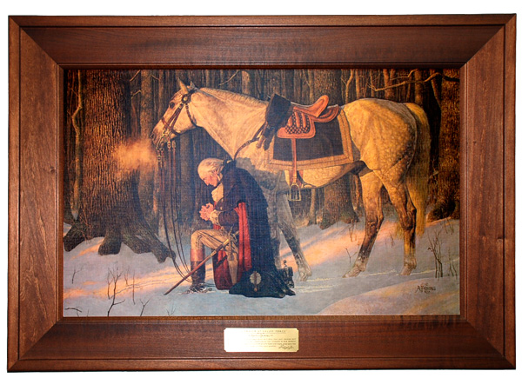

Slide 84
Command and Leadership
The Modern Practicing Stoics View
Only practitioners can define
Skin In The Game

Slide 85
Three Disciplines of Command
Discipline of Perception
Discipline of Action
Discipline of Will

Slide 86
Four Fundamental Virtues
Self Control
Courage
Justice
Wisdom

Slide 87
The Triad Nassim Taleb
Fragile
  Things that dislike disturbances
Robust
  Things that are neutral to disturbances
Anti-fragile
  Things that like disturbances

Slide 88
Influencers on volitility
Risk
  Underestimated
  Based on previous experience
Size
  Large ^ fragility
Complexity
  Nonlinearity

Slide 89
Trauma
Post Traumatic Stress
Post Traumatic Growth
Significant events
Normal stress
Triggers
Training
Conditioning
Environment
Significant events
Normal stress
Triggers
Training
Conditioning
Environment

Slide 90
Post Traumatic Growth
new opportunities or possibilities in life
increased sense of personal strength
change in relationships with others
greater appreciation for life in general
deepening of spiritual life

Slide 91
Post Traumatic Growth
“Affliction produces endurance and endurance produces a proven character and a proven character produces hope and hope is not put to shame”
        In a letter by Paul to the Corinthians
Suffering can help us care more

Slide 92
“Leadership under pressure will often entail being a moralist, jurist, teacher, steward and philosopher.”
-ADM James B. Stockdale

Slide 93
Morality
Morality is what conforms to ethical standards
Immoral is something that does not
Amoral lacks any moral sense

Slide 94
Being a Commander
Vision of the Commander
The Challenges of the Commander
The Commander as a Tactician
The Commander as a Firefighter
The Commander as a Moral Arbiter
The Commander’s Concept of Duty
The Commander as a Strategist
The Commander as a Mentor

Slide 95
To Command
Command
  To be in a position that has a wide view
  A thorough knowledge of something
  A moral and ethical undertaking

Slide 96
To Command
To direct with authority
To think and make judgements
Responsibility to save and risk lives
Set and enforce moral standards
To act and wield power

Slide 97
To Command
Commanding fire companies and personnel is one of the few human endeavors that cannot be learned by taking courses leading to a degree in “Commandership”
Command is personal
Command is a lifestyle

Slide 98
To Command
To Command is manage well when called for
To Lead well when leadership is called for
To carry out orders and follow the rules when “going by the book” is all that is required
But to confuse each of these three with the full scope of the command / leadership function is to underestimate the need for taking intellectual and moral responsibility in the performance of ones duties.

Slide 99
The Vision of the Commander
Worldview
Role in the community
Vision of future selves
Today's problems
Relationship between firefighter / public
Essential virtue of courage

Slide 100
Worldview
“Constantly think of the universe as a single living being, comprised of a single substance and a single soul; and how all things issue into the single perception of this being, and how it accomplishes all things through a single impulse; and how all things work together to cause all that comes to be, and how intricate and densely woven is the fabric formed by their interweaving” –
    Marcus Aurelius, Meditations, 4.40

Slide 101
Challenges of Command
Making quality judgments
How to employ specialized knowledge
Responsibility for protecting life
Firefighters conduct towards one another
To command is to think and decide, to feel and moralize and to act and wield power.

Slide 102
Ultimate Challenge of Command
“Your position never gives you the right to command. It only imposes on you the duty of so living your life that others can receive your orders without being humiliated.”
  Dag Hammarskjold

Slide 103
Command and Tactics
Greek “taktos” things that are ordered or arranged such as in formations
Role of tactics
Tactical evolution
Iterate innovate and improve
Grand tactics, Minor tactics, Applied tactics.

Slide 104
The Commander as a Firefighter
Demands on fire commanders
  Personally courageous
  Function usefully in hazardous & chaotic conditions
  Able to fight off fatigue
  Able to continuously inspire
  Committed to success regardless of the obstacles bad luck or the incompetence of others.

Slide 105
The Commander as Moral Arbiter
Setting standards for moral conduct
Character and environment
Supporting core policies
Four kinds of tests
  Honesty and integrity
  Skill in work
  Compassion
  Courage

Slide 106
The Concept of Duty
Mutual Trust and Obligation
Obey and carry out orders
Care for and build strong companies
Uphold professional and ethical code
Self Development to the highest
Fidelity to family, friends and teammates
Uphold moral principals

Slide 107
Command and Strategy
Greek Strategos :”the art of the general”
Employing forces to secure objectives
Knowing theoretical bases
Allocating resources
Maintaining a balance
Tradition, Evolution, Resources, Threats

Slide 108
Command and Mentoring
Clear vision of yourself
Enhanced capacity for mental, moral, and action oriented requirements
Quality tacticians, firefighters, moral leaders, and strategists
Undergird courage, sense of duty, dedication to justice, compulsive trainers
Promote “Post Traumatic Growth”

Slide 109
Command & Leadership
Leadership is not defined by the scale of the opportunity but by the quality of the response
Mrs. Washington
  “All I am I owe to my mother. I attribute all my success in life to the moral, intellectual and physical education I received from her.“
        George Washington

Slide 110
Leadership
Leadership = Command and Control.
  We are all leaders all of the time
  Leadership is training every recruit to be a leader.
  ALL Leadership starts with Self Leadership

Slide 111
Self Leadership
Self Awareness / Self Discipline
Ingenuity- Innovation
Love / Passion
Courage and Heroism

Slide 112
Self Leadership
About who you are
It is a way of life
It is a life long process
Leaders must equip recruits and their members to discern ON THEIR OWN what to do in dynamic situations

Slide 113
Self-discipline Achieved
"Most powerful is he who has himself in his own power"
Seneca the Younger

Slide 114
Company Leadership
Correctly designate company goals
Demand high standards in discipline
Develop subordinates
Make certain firefighters know you care

Slide 115
Stogdill Leader Behavior
Applies pressure for productive output
Exhibits foresight and ability to predict
Maintains closely knit company
Maintains cordial relations with superiors
Does not surrender leadership role
Allows members scope for initiative
Clearly defines own role

Slide 116
Stogdill Leader Behavior
Lets company know what is expected
Uses persuasion and argument effectively
Exhibits strong convictions
Tolerates uncertainty without anxiety
Reconciles conflicting organizational demands
Speaks and acts as chief representative in all significant situations

Slide 117
4 Principles of Leaders
Understand their strengths, weaknesses, values, and desires
Confidently and innovatively adapt to an ever changing world.
Engage others with a positive and loving attitude
Energize themselves and others through heroic ambitions

Slide 118
Learning Objectives for Commanders
Knowledge
  Data, facts, theories, concepts
Skills
  Technical, communications, analytical
Insights
  The true nature of things, education
Values
  Convictions, fundamental beliefs, standards

Slide 119
Traits of Commanders / Leaders
Commanders know themselves and embrace an ever changing world with love of self and others
  Self-awareness
  Ingenuity
  Love
  Heroism
One way of life

Slide 120
How to be a leader
1st. you must believe you are leading leaders
  Appreciate your own dignity and potential
  Recognize the weakness and attachment that block you
  Articulate the values you stand for and be ready to defend them
  Establish personal goals and strive to meet them
  Listen to what others have to say.

Slide 121
How to be a leader
Form your point of view on the world, where you stand, what you want and how you will relate to others
See the wisdom and value in self awareness and commit to it
Daily self reflection

Slide 122
The Moral Sense
Sympathy
Fairness
  Aristotle “what is just …is what is proportionate”
Self-Control
Duty

Slide 123
Character
Distinctive set of qualities – personality
A moral sense or integrity
Habit –routine ways of doing things
  Courtesy – alerts us to the feelings of others
  Punctuality – disposes us to be dutiful
  Practice – master the skills, capable of excellence

Slide 124
Justice
Restorative
Retributive

Slide 125
Importance of Decision Making
Commanders must be able to detect the acceleration of harm applies to anything that entails decision making under uncertainty
requires balance of risk management
demands appreciation of randomness

Slide 126
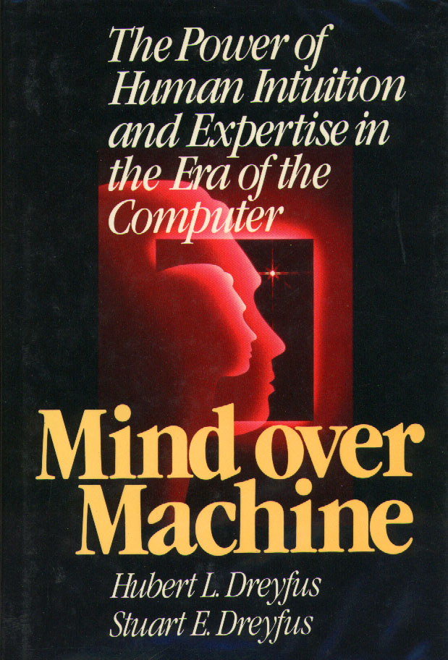
Decision Making Research
Describes the path from novice to expert
  Novice
  Advanced beginner
  Competent
  Proficient
  Expert
Analytical
Intuitive

Slide 127

Decision Making Research
Research conducted with experts
How experts make decisions
Recognition-primed decision making model
Implications for Commanders

Slide 128
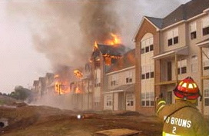
“If you want people to size-up situations quickly and accurately, you need to expand their experience base.”
Gary Klein, Klein Associates Inc.

Slide 129
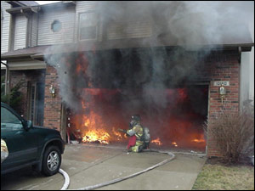
Naturalistic Decision Making
The effort to understand and improve decision making in field settings
Development of expertise
Study of decision making in “context”
Development of decision making tools, training and supports

Slide 130
“Context” in Fireground Decisions
Low Frequency / High Impact
  No discretionary time
  Limited experience
  High stress
  No clear goals
  Inadequate information
  Limited resources
  Uncertainty

Slide 131
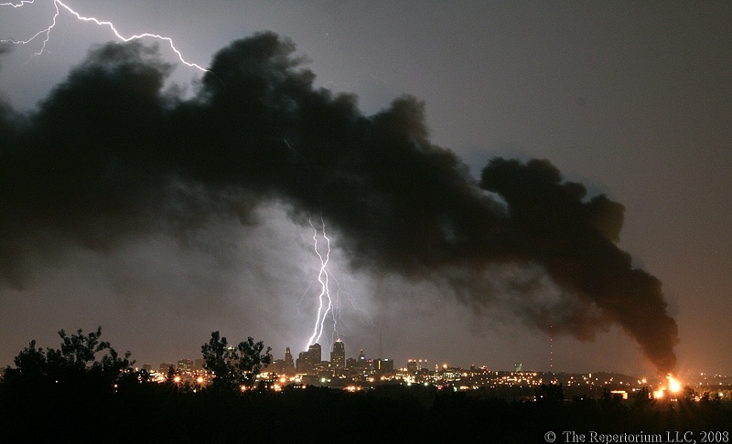
Naturalistic Decision Making
Recognition Primed Decision Making
  Mental files of experience
  Mental simulations
  Workable option
  Discrepancies
  Cues

Slide 132
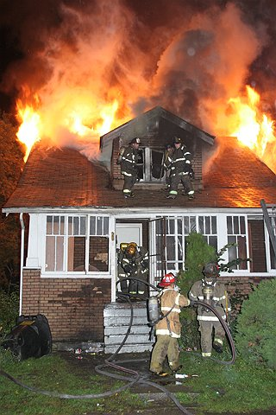
Cues
Fire location
Crowd activities
Smoke conditions
Unusual # of patients
Excessive amount of fire
Multiple locations on arrival
Feeling or hunch “something wrong”

Slide 133
RPD Model
Patterns
Cues let us recognize patterns
Patterns activate action scripts
Action scripts are made by mental simulation
Mental simulation is driven by mental models

Slide 134
Pattern Recognition Process
Situation
generates
to affect the
Cues
Action Scripts
that let you recognize
Patterns
that activates

Slide 135
Klein’s Recognition-Primed Model
Situation
to affect the
generates
Mental Simulation
Cues
using your
Action Scripts
which you assess by
Mental Models
that let you recognize
that activates
Patterns

Slide 136
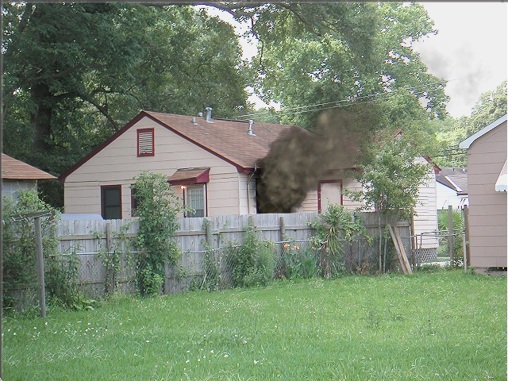

Slide 137
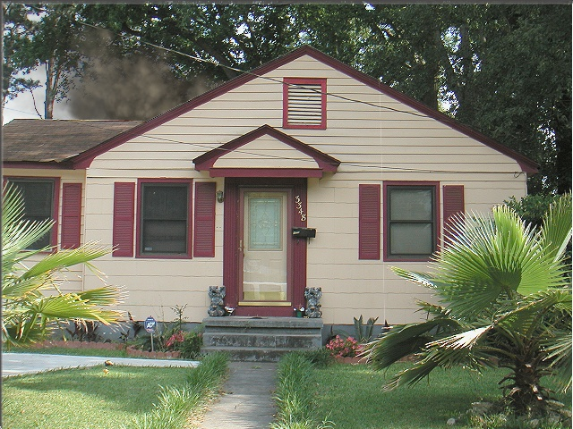

Slide 138

Intuition and Mental Models
People deduce, believe, that a conclusion:
Must be true, if it holds in all of their models
Likely to be true, if it holds in most of their models
May be true, if it holds up in at least one of their models

Slide 139
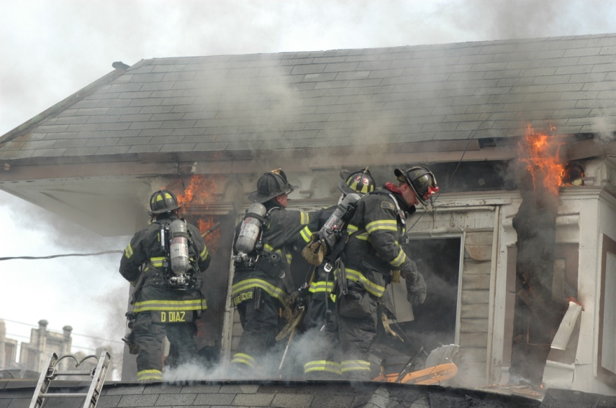
Mental Models
Derived from experience
Can be misapplied
Represents one possibility
Captures what is common
Represent explicitly what is true, but not what is false

Slide 140
Cognitive Bias
According to Dr. Dutch Leonard, Cognitive Bias defines the reason why that sometimes under pressure we believe “what we’re doing is going to somehow work, when all indications are that it is not”

Slide 141
Human Biases During Decision Making
Desire for self-fulfilling prophecies
  Person values a certain outcome or conclusion and acquires and analyzes only information that supports it
Expectations
  People place more weight on information that confirms what they expect than information that contradicts it

Slide 142
Human Biases During Decision Making
Habit
  Familiarity with a particular rule for solving a problem results in its reuse (having a solution looking for a problem)
Illusion of Control
  A good outcome in chance situations may have resulted from a poor decision the resulting feeling of control may not be reasonable

Slide 143
Effects of Cognitive Biases
Failure to notice the current plan is not working
Redoubling the effort instead of changing the plan
Fixation on the the current plan
Staying with the initial attack despite deteriorating conditions

Slide 144
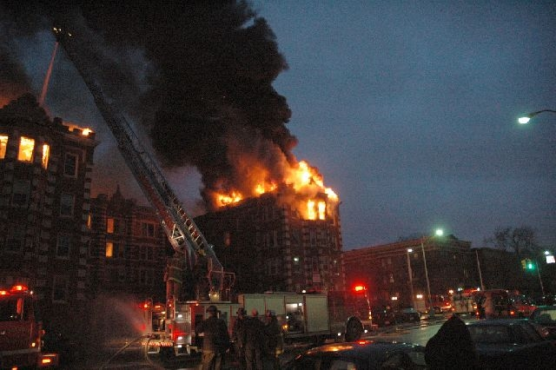
Dynamic Complexity
& Decision Making

Slide 145

The Challenges of Dynamic Complexity
Events highly interconnected
Exceed intuition based decision making
Limitations of feedback
Requires support systems augment RPD
  Structural analysis / recon and updates
  Cause and effect
  Tactical responsibilities
  Focused reactions to changing dynamics

Slide 146
Complexity on the Fireground
Inter-related forces and actions
  Fire / fuels / ventilation / extinguishment
Spontaneous re-organization
  Fire growth and development / ventilation
7-bit rule / local awareness
  Local in time means short term
“We therefore know of the unknowable, manage within the unmanageable, and organize within the un-organisable.” Flood 1999

Slide 147
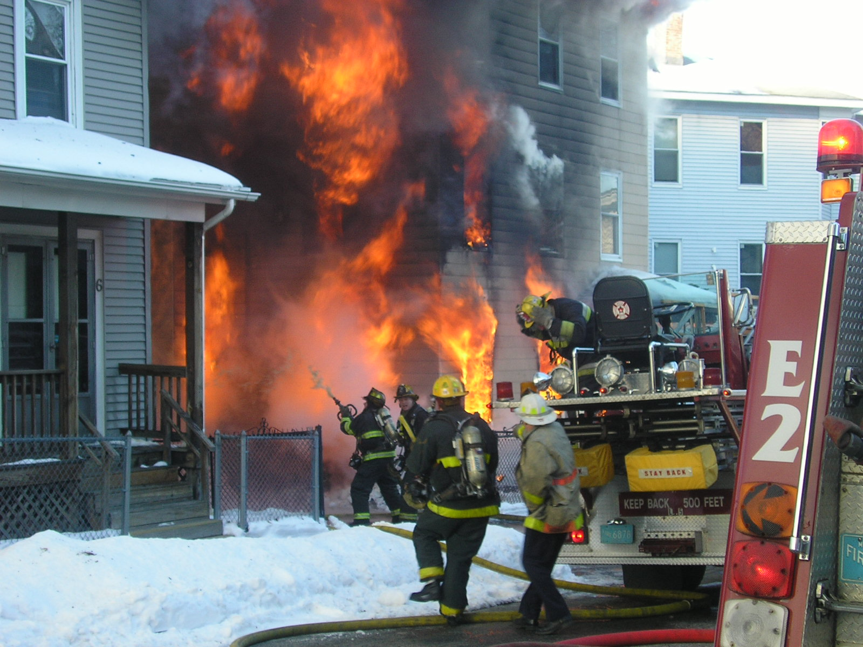
Working In and On Critical Boundaries, Exposes Us to the Unpredictable Quality of Natural Self Organizing Systems
“Strange things happen near the boundaries.” James Gleick Chaos

Slide 148
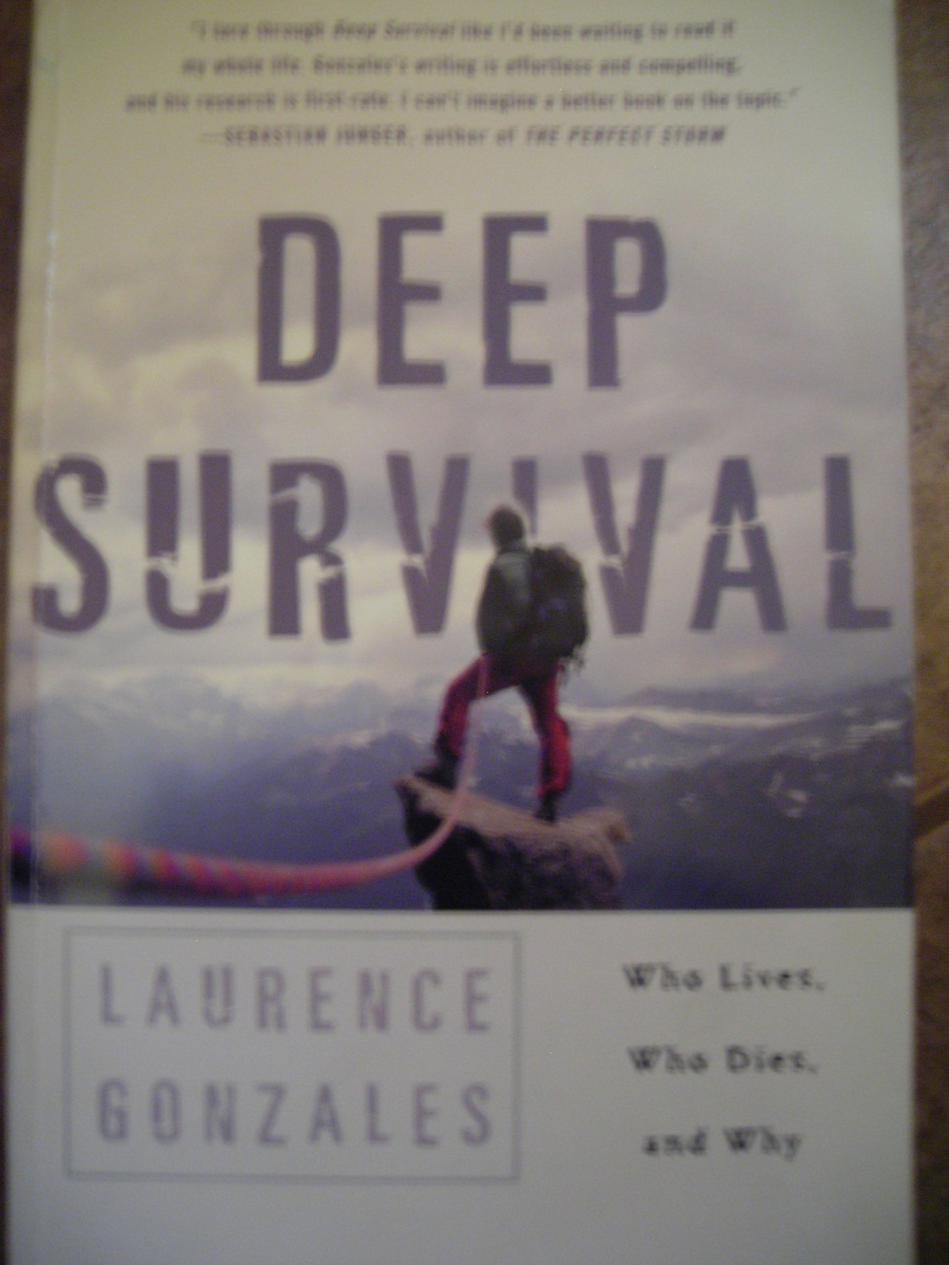
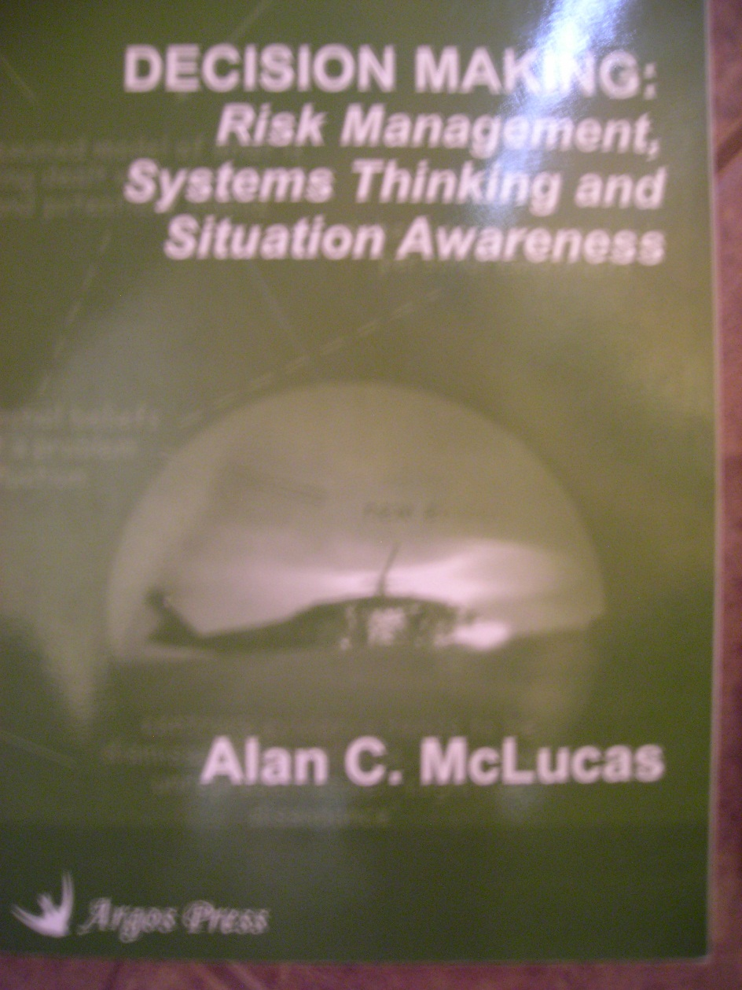
Surviving Critical Natural Boundaries

Slide 149
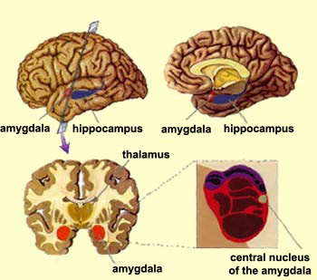
Amygdala

Slide 150
Immediate Decisions / Survival
During a fear reaction emotion takes over
The amygdala comes to dominate memory
Less then 10% are resistant
“The amygdala is the centerpiece of the defense system.” Joesph LeDoux
The Emotional Brain and the Synaptic Self

Slide 151

Uncertainty's Effects on DM
Uncertainty is processed in the Amygdala
  Emotional center
  Oldest part of brain
Highly connected to sense of fear
Emotion versus cognition / reason
Experience is believed true and unduly weighted in future decisions

Slide 152

Cognition and Tools
Lacking Model or Experience
  Alternative DM supports
Complex systemic dynamic behavior
  Scenario planning
  7 bit rule
  Shift responsibilities to lower levels

Slide 153
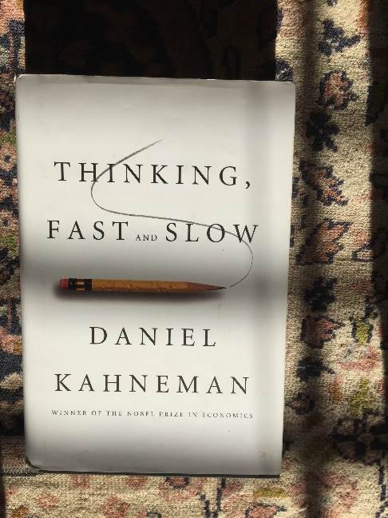
Decision Making
System 1
  RPD Klein
  Solo
System 2
  Options, analytical,
  Collaborative
  Supported

Slide 154
Issue Resolving MODEL
Issue
Goal
Actions
Reasons
Follow-up – measures
Inform
Document

Slide 155
Issue Resolving
Issue
    identify the issue in the situation
  Moral
  Legal
  Process
  Other
  Systemic

Slide 156
Issue Resolving
Goals
  specify the results you will accomplish
  envision the resolution the situation
  be able to describe this result in detail
  prioritize the goals necessary

Slide 157
Issue Resolving
Actions
  describe the actions
    you will take
    decisions you will make
    orders you will give
    requests you will make
Be specific, detailed and proactive
Address them in chronological order

Slide 158
Issue Resolving
Reasons
Provide reasons for your:
  actions, decisions, orders, directions and requests
Focus on what is important to making your solution work locally
Always keep in mind Policy Integrity Effectiveness and Safety

Slide 159
Issue Resolving
Document
Maintain all
  reports, logs, memos, letters, notes, journal entries, emails
Delegate when necessary ancillary reports
Distribute documentation as necessary

Slide 160
Issue Resolving
Inform
Always keep your superior officer informed
Tell others about the
  decisions, actions, orders, requests
Employ the gunsight technique
  above/customer and peers/outside agencies sections/below

Slide 161
Issue Resolving
Follow-up
Take whatever actions necessary to assess solution to include:
    meetings, reports, training, mentoring, phone calls, personal contacts, email
Ensure time frames, due dates and guidelines and directives are met
Review, revise and redirect when necessary or when confronted with conflicting information

Slide 162
The Three Laws of Performance
First Law: When looking at situations from the perspective of the Three Laws, one will realize that how a situation occurs to other individuals is more critical than what they think about the situation.

Slide 163
The Three Laws of Performance
How people perform correlates to how situations occur to them.
  When a person takes action, it always makes complete sense to them.
Each person assumes that the way things occur for them is how they are occurring for another.
How a person experiences a situation is based on one’s personal perspective and past history.
How a situation occurs for a person includes their view of the past (why things are the way they are) and the future (where things are going).

Slide 164
3 Laws of Performance
First Law of Performance:
  How people perform correlates to how situations occur to them
Leadership Corollary 1:
  Leaders have a say, and give others a say, in how situations occur

Slide 165
The Three Laws of Performance
• Second Law:
  A person may observe how people’s use of language expresses, sustains, and holds in place the way in which situations occur to them. One may also become aware that most people talk about the future in terms of the past. It will be clear that their actions correlate with their default futures.

Slide 166
The Second Law of Performance
How a situation occurs arises in language
  Language includes spoken and written, body language, facial expressions, tone of voice, pictures and drawings, any actions that have symbolic intent.
Whenever something is said, other communication is carried along with it, “the unsaid but communicated”.
When it comes to elevating performance, the unsaid is the most important part.
  The unsaid but communicated includes assumptions, expectations, disappointments, resentments, regrets, interpretations, significance, and issues that occur as dangerous.

Slide 167
3 Laws of Performance
Second Law of Performance:
  How a situation occurs arises in language
Leadership Corollary 2:
  Leaders master the conversational environment.

Slide 168
The Three Laws of Performance
Third Law:
  One will see that only a few people talk generatively. Instead of merely describing, these people use language to create new futures

Slide 169
The Third Law of Performance
There are two different ways to use language.
The first is descriptive – that is, using language to depict or represent things as they are or have been. Descriptive language has its limits. One cannot create something new merely by describing what was and is. Using descriptive language to talk about the future is limited to prediction based on past cycles and current realities.
Future-based language, also called generative language, has the power to create new futures, to craft vision, and to eliminate the blinders that are preventing people from seeing possibilities. It does not describe how a situation occurs. Instead it transforms how it occurs by rewriting the future.
A universal principle is that people live into the future they see coming at them, not the actual future they will get to someday. Unless people have done something radical to alter their course, the future they are living into is their default future. The default future consists of a person’s expectations, fears hopes, and predictions, all of which are ultimately based on one’s experience in the past.

Slide 170
3 Laws of Performance
Third Law of Performance:
  Future-based language transforms how situations occur to people
Leadership Corollary 3:
  Leaders listen for the future of their organization

Slide 171
Improving Performance Organization-Wide
Get out of the stands.
In the stands at a football game, people talk about the game, but, their conversations have no impact on the action of the game. In contrast, the conversations the players are having on the field are the essence of the game. A person leaves the stands when they stop assessing and judging, and instead puts something at risk and communicates in a way that drives action as well as makes them accountable for winning the game.

Slide 172
Improving Performance Organization-Wide
Create a new game. A game starts when an influential person uses future-based language to declare that something is more important than something else. This is what is put at stake and what that person will be held accountable to.

Slide 173
Improving Performance Organization-Wide
Make the obstacles conditions of the game. If something occurs to a person as an obstacle, then that person will push back by playing on the obstacle’s terms. It is important to make the obstacles conditions of the game.

Slide 174
Improving Performance Organization-Wide
Share insights.
  Breakthrough performance is possible when a person engages others in the insight from the Three Laws by sharing information. When sharing occurs, other people take on performance challenges in a collaborative way and form a network.

Slide 175
Improving Performance Organization-Wide
Find the right coaching.
  Great coaching alters the situation of how the game occurs for the players, especially at critical moments. The coach says and does whatever is necessary to win the game. As a person creates a network that takes on breakthrough performance challenges, they will find themselves coaching.

Slide 176
Improving Performance Organization-Wide
Start filing the past in the past.
  When humans encounter stressful events, they survive, note what worked, and keep it on file for future reference. Over time, the filing cabinet of The Future becomes full. The irony is that a real future no longer exists. In order to create a future with a blank canvas events from the past must be kept in the past.

Slide 177
Improving Performance Organization-Wide
Play the game as if life depended on it. Begin coaching by starting with oneself. Overturn life sentences and create a powerful future to live into. People will resist because it is human nature to resist new ideas all the time.

